Slide 1


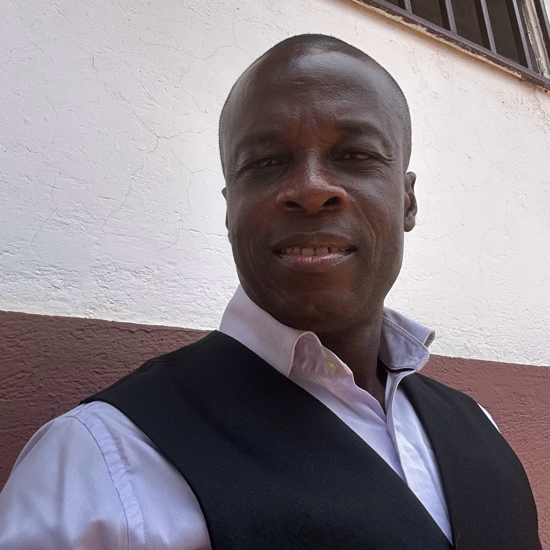
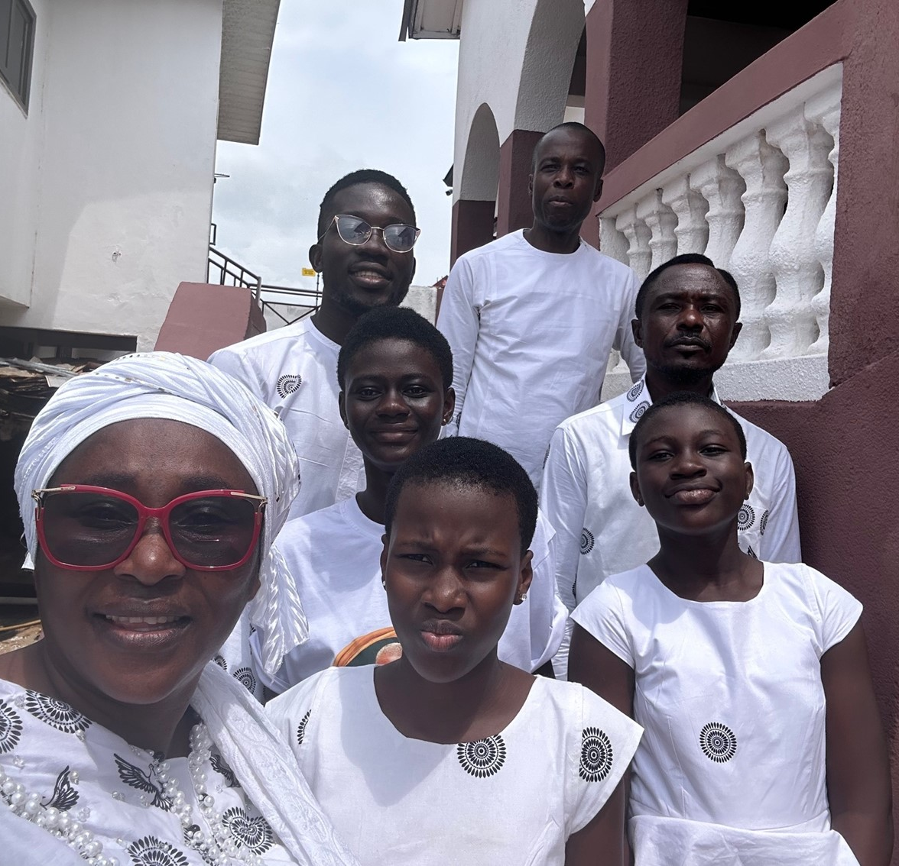
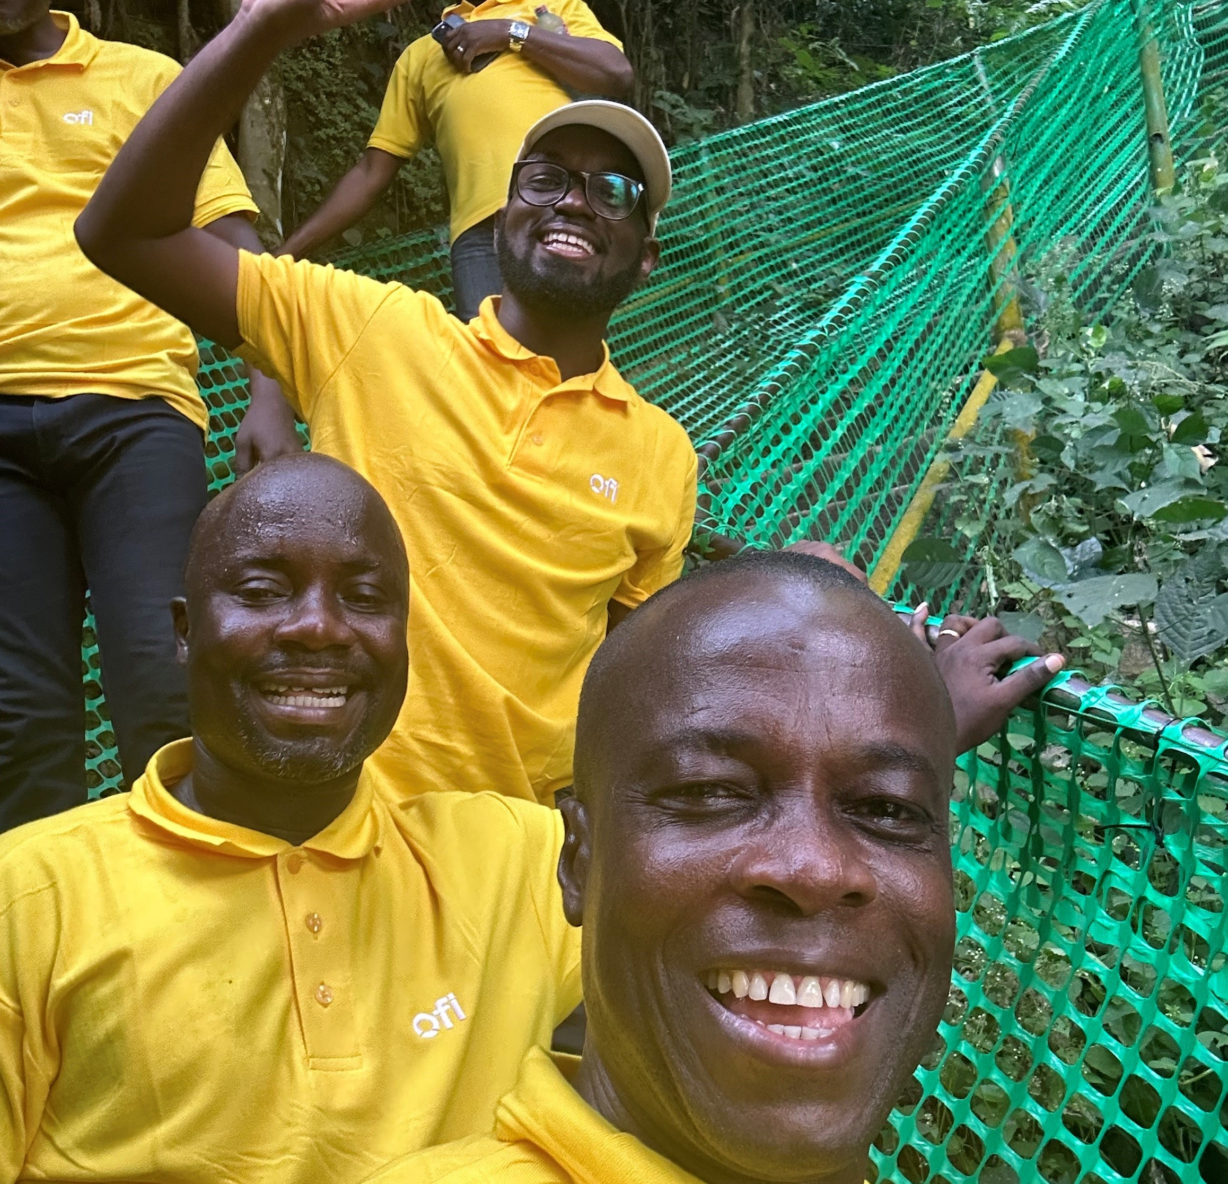
Getting to Know Me
Work
Personal
My role
Sustainabilty Head
Significant others / family members / furry friends in my life
Wife, Kids, colleagues at work and church leaders
Tenure in ofi/Olam
26
How I enjoy spending my free time
Reading books and watching documentaries
Previous companies I have worked at
Entire life with ofi/Olam
My favorite / comfort food
Mid day Fufu with dawadawa in dried Okra soup
Why I joined ofi/Olam and what keeps me here?
As a means of earning income and pursuing my passion. Improving farmer livelihood that allows me to be the change
My favorite song
We are the world
Kennedy Ntoso
‘Kennedy’
I am a WWE fanatic
This is me outside work, doing stuff I enjoy in my life …

